Slide 1


STOCK MARKET PREDICTION
NAME OF THE SUPERVISOR |  | PROJECT MEMBERS
INTERNAL GUIDE:
Dr.S.K.MUTHUSUNDAR M.E,Ph.D.,
Professor,
Dept. of Computer Science & Engineering
HEAD OF THE DEPARTMENT:
Dr. S. PAVITHRA, M.E., Ph.D.,
Associate Professor,
Dept. of Computer Science & Engineering
DEPARTMENT OF COMPUTER SCIENCE
& ENGINEERING
1. P RATISH (210419104126)
2. SANKEERTH S NARAYAN (210419104145)
CHENNAI INSTITUTE OF TECHNOLOGY, CHENNAI-600069
21-06-2022
Department of CSE - CS 8611 Project Work
1

Slide 2
Agenda
Abstract
Objective
Introduction
Literature Survey
Existing System
Proposed System
System Design
Results
References
21-06-2022
Department of CSE - CS 8611 Project Work
2

Slide 3
1. Abstract
Stock market prediction is an act of trying to determine the future value of a stock other financial instrument traded on a financial exchange. In this work we use Machine learning architectures Long Short-Term Memory (LSTM), Autoregressive Integrated Moving Average (ARIMA) forecasting of NSE listed companies and differentiating their performance. With the advent of technological marvels like global digitization, the prediction of the stock market has entered a technologically advanced era, revamping the old model of trading. Advanced trading models enable researchers to predict the market using nontraditional textual data from social platforms.
21-06-2022
Department of CSE - CS 8611 Project Work
3

Slide 4
2. Objective​
Stock Market prices prediction is the act of trying to determine the future value of a company's stock or other financial instrument traded on an exchange.​
So when we make an accurate prediction of share price movement , it might lead to profits investors can make.​
Predicting stocks are not an easy task as it requires a lot of physical and psychological factors. Manual predictions nowadays is practically not possible ​
We will be using Machine Learning algorithms for the prediction.
21-06-2022
Department of CSE - CS 8611 Project Work
4

Slide 5
3. Introduction
Stock Market is one of the oldest methods where a normal person would trade stocks, make investments and earn some money out of companies that sell a part of themselves on this platform. Stock market provides a platform for almost all major economic transactions in the world at a dynamic rate called the stock value which is based on market equilibrium. With the advent of technology, researchers demonstrated that stock market prices could be predicted to a certain extent. Using Machine Learning Technique will be analyzing the stocks of previous year to predict the current prices.
21-06-2022
Department of CSE - CS 8611 Project Work
5

Slide 6
4. Literature Survey
There were two important indicators in the literature for stock price forecasting. They are fundamental and technical analysis. Both were used to analyze the stock market.[6]
This paper is a survey on the application of neural networks in forecasting stock market prices. With their ability to discover patterns in nonlinear and chaotic systems, neural networks offer the ability to predict market directions more accurately than current techniques.[7]
This paper is a survey on the application of neural networks in forecasting stock market prices. With their ability to discover patterns in nonlinear and chaotic systems, neural networks offer the ability to predict market directions more accurately than current techniques.[2][5]
21-06-2022
Department of CSE - CS 8611 Project Work
6

Slide 7
5.1 Existing System
5.2 Drawbacks in Existing System
Support Vector Machine (SVM)
Autoregressive Moving Average (ARMA)
Random walk (RW) technique
Random Forest
Traditional Regression Model
The existing system fails when there are rare outcomes or predictors, as the algorithm is based on bootstrap sampling.
The previous results indicate that the stock price is unpredictable when the traditional classifier is used.
21-06-2022
Department of CSE - CS 8611 Project Work
7

Slide 8
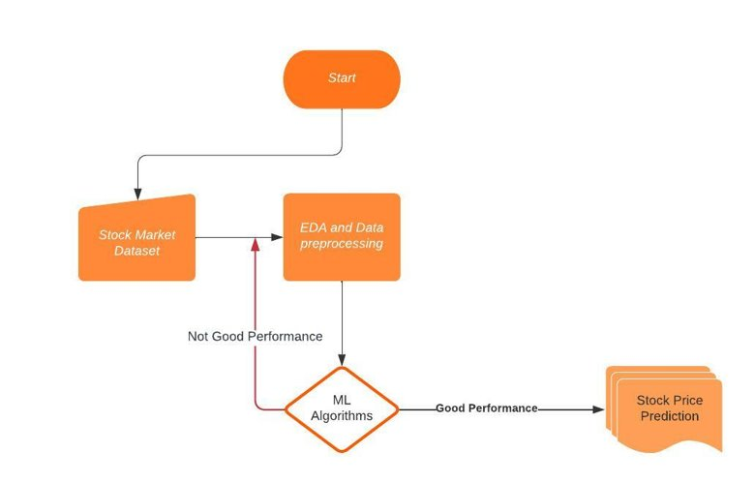
6. Proposed System
LSTM Model:
LSTM has a chain organization that contains four neural networks and different memory blocks called cells.
ARIMA Model:
It is an ARMA model fitted on d-th order differenced time series such that the final differenced time series is stationary.
21-06-2022
Department of CSE - CS 8611 Project Work
8

Slide 9
6.1 Advantages of Proposed System
6.2 Scope
LSTMs provide us with a large range of parameters such as learning rates, and input and output biases. Hence, no need for fine adjustments. The complexity to update each weight is reduced to O(1) with LSTMs, similar to that of Back Propagation Through Time (BPTT).
ARIMA model provides managers with reliable guidelines in making decisions related to supply chains. ARIMA models can also be used to predict the future price of your stocks based on the past prices.
The scope is to create a model that predicts the future stock price using LSTM and ARIMA Model
21-06-2022
Department of CSE - CS 8611 Project Work
9

Slide 10
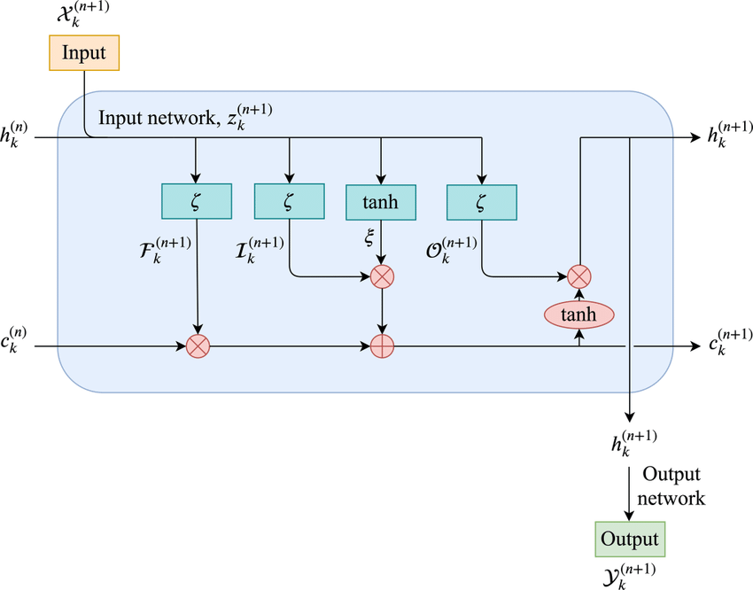
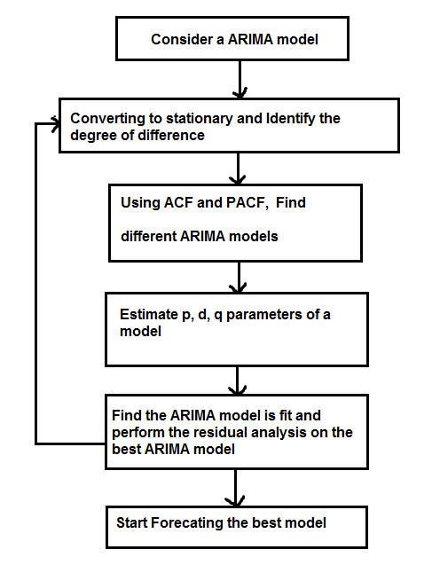
7. System Design
LSTM Model
ARIMA Model
21-06-2022
Department of CSE - CS 8611 Project Work
10

Slide 11
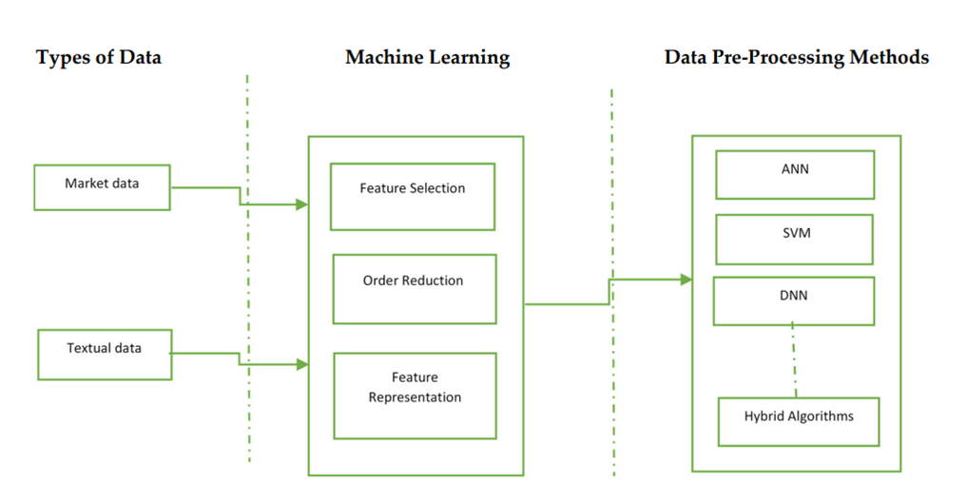
8. Methodology
1. The data is preprocessed using data Processing techniques. 2. The processed data is passed as training data for the model. 3. After the model is trained predictions are made.
21-06-2022
Department of CSE - CS 8611 Project Work
11

Slide 12
9. Requirements
Technology Used:
Sklearn
Keras
statsmodels.tsa.arima_model
Tensorflow
Hardware Tool:
Processor- IntelCore
Operating System- Windows 10 (64-bit)
RAM- 8 GB
Software Tool:
Anaconda
Jupyter notebook
21-06-2022
Department of CSE - CS 8611 Project Work
12

Slide 13
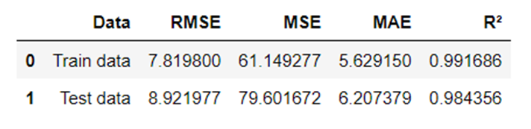
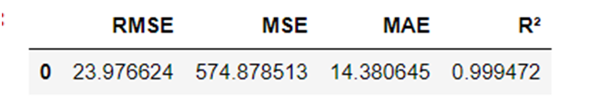
10. Implementation
Performance Metrics of LSTM Model
Performance Metrics of ARIMA Model
21-06-2022
Department of CSE - CS 8611 Project Work
13

Slide 14
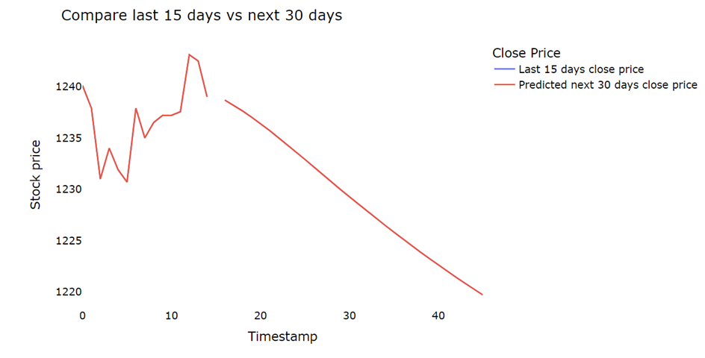
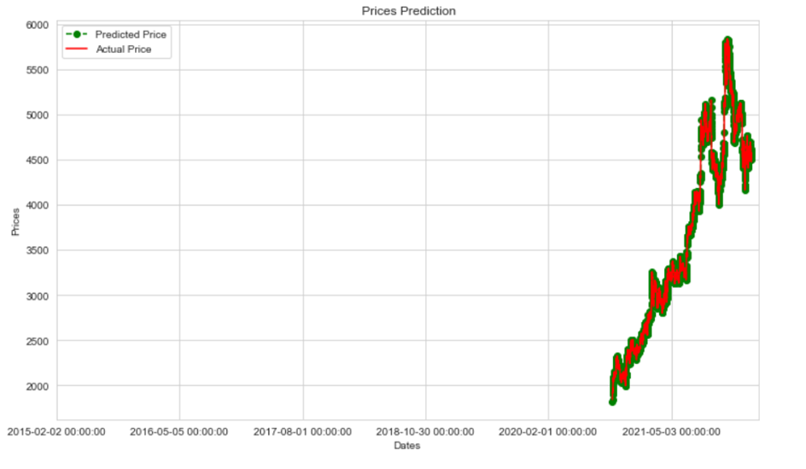
11. Results
LSTM Model prediction for next 30 days
Predictions of ARIMA model
21-06-2022
Department of CSE - CS 8611 Project Work
14

Slide 15
12.1 Conclusion:
We have developed a model for predicting close stock price using LSTM algorithm and ARIMA.
We have used datasets belonging to NestleIN-D, Apollo, TCS, Infosys ,HDFC, IOC and DLF and achieved above 99% accuracy in both the for these datasets.
12.2 Future Scope:
In the future, we can extend this application for predicting crypto currency trading and we can add sentiment analysis for better predictions.
We can consider the external factors that affect stock price like news for prediction. An application like a website or an APP can be made using this model
21-06-2022
Department of CSE - CS 8611 Project Work
15

Slide 16
13. References
[1] Stock Price Prediction Using LSTM on Indian Share Market by Achyut Ghosh, Soumik Bose1, GiridharMaji, Narayan C. Debnath, Soumya Sen
[2] S. Selvin, R. Vinayakumar, E. A. Gopalkrishnan, V. K. Menon and K. P. Soman - Stock price predictionusing LSTM, RNN and CNN-sliding window model - 2017.
[3] Stock Market Prediction Using Machine Learning Techniques: A Decade Survey on Methodologies, Recent Developments, and Future Directions Nusrat Rouf 1 , Majid Bashir Malik 2 , Tasleem Arif 3 , Sparsh Sharma 4 , Saurabh Singh 5 , Satyabrata Aich 6,* and Hee-Cheol Kim 7
[4] Stock Market Prediction Using Machine Learning V Kranthi Sai Reddy1
[5] Prediction Models for Indian Stock Market
21-06-2022
Department of CSE - CS 8611 Project Work
16

Slide 17
[6] A Survey on Stock Market Prediction UsingMachine Learning Techniques Polamuri Subba Rao1(&), K. Srinivas2, and A. Krishna Mohan3
[7] A Literature Survey on Stocks Predictions using Hybrid Machine Learning and Deep Learning Models , Prof. Vibha Lahane , Rahul Mangalampalli , Vaibhav Malviya , Pawan Khetre, Vivek Pandey
21-06-2022
Department of CSE - CS 8611 Project Work
17

Slide 18
THANK YOU
21-06-2022
Department of CSE - CS 8611 Project Work
18

